Slide 1
Centralized Database Management: Enhancing User Interaction and Accessibility with R / Shiny and AWS
Ilaria Capelli & Mina Sohrabi
UseR! 2024, Salzburg, 09.07.2024

Slide 2

This presentation is intended for information purposes. This presentation constitutes neither a public offer nor a solicitation to submit an offer in the sense of the Austrian Capital Market Act (KMG), the Stock Exchange Act or any other comparable foreign law. An investment decision regarding a financial product must be made on the basis of an approved, published prospectus and not on the basis of this presentation. This presentation does not constitute a personal recommendation/investment advice regarding the purchase or sale of financial instruments in the sense of the Securities Supervision Act. This presentation shall not form the basis for any kind of contract or commitment whatsoever. This presentation is not a substitute for the necessary advice on the purchase or sale of a financial product. Your banking advisor can provide individualised advice which is suitable for investors and investments.

Slide 3
01 | About us: who we are and what are out digital needs
02 | Why do we need a Centralized Database Management
03 | An internal R package for direct queries
04 | Macro Forecast DataHub: a Shiny-based application
05 | Summary and Outlook

Slide 4
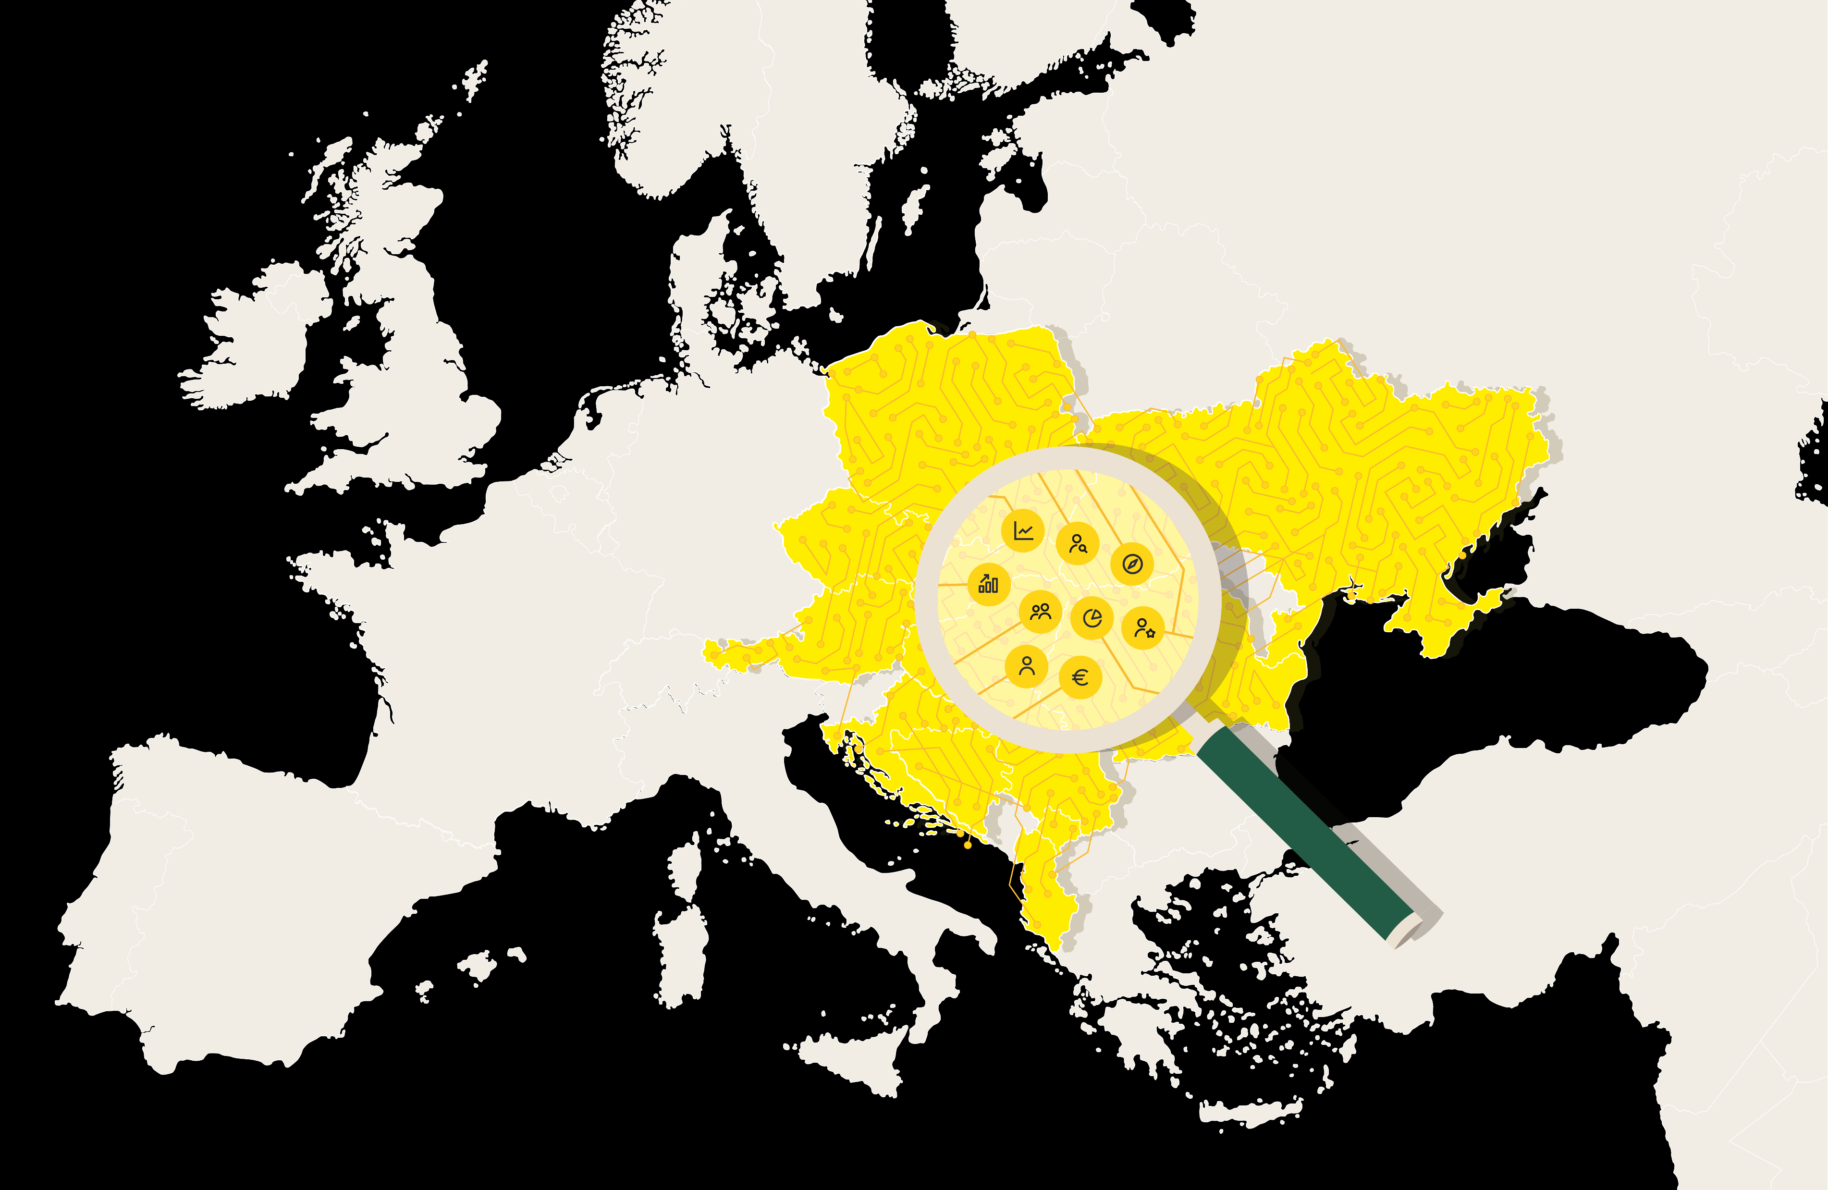

About us: who we are and what do we do?
Granular coverage of CEE & Austrian markets and issuers
Macro, Fixed Income, Equity, ESG
Diverse team of ~80 analysts in Austria and 12 CEE countries
Local market expertise
Strong regional, product and client focus
Exclusive Research provider to Austrian Raiffeisen Banking Group in retail research
Data and models used by several departments
www.raiffeisenresearch.com

Slide 5


About us: one platform, countless insights
Stakeholders' expectations
Need for reliable, digital and sustainable research
Urge for local expertise in 12 CEE countries and Vienna
What we offer
Up to date, ad hoc, latest research
Analysts contacts & local expertise on your request
Need to serve corporate & institutional clients
Data always ready and up to date
Access to research community events
Unique database & platform to analysts & clients
www.raiffeisenresearch.com

Slide 6
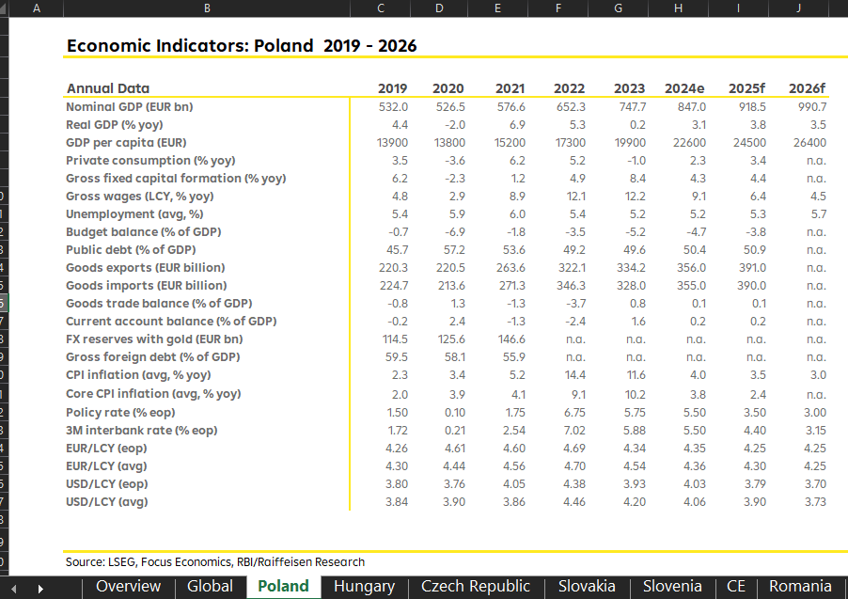


Current vs future environment

Slide 7


Current vs future environment
Many transfer sheets
Multiple data sources
Vulnerable to overwriting
Limited back-testing capability
Data downloads based on cell reading, highly error-prone
One interface
One database
Only authorized users can edit
Any revision is stored with author and revision date
API for data download in R

Slide 8

Role- based access control model
Users
Roles
Rights
everything
Pub
READ
WRITE all
WRITE country - restricted
CREATE
DELETE
Dashboard owner/ CEE Lead
DH_Admin
everything
Country lead
DH_Country_lead
Country analysts/
Students
DH_Country_analyst
Draft
READ
WRITE all
WRITE country - restricted
CREATE
DELETE
External Guests
DH_Guest

Slide 9






A modern view for research data handling
For further details, refer to the following light-talk:
Automated Generation of R Client Libraries for RESTful APIs, Dr. Simon Haller, 11.07 10:40, Pongau + Flachgau

Slide 10
HTTP Methods
Via our R client it is now possible to perform various HTTP methods in the database of
our macro-economic timeseries:
library(rdhsdk)​
client<-ApiClient$new(base_path, bearer_token)​
dh<-TimeseriesApi$new(client)
Initialization:
GET:
table <- dh$get_data_bulk(instrument_name, datafield_name, freq, variant, start_date, end_date, version)
POST:
to_post <- dh$post_publish_bulk(instrument_name, datafield_name,freq,variant, version, target_version)
Notes:
Main messages: 1. who is capable to use R can query directly via R and use the data within R (charts, data analysis,...) 2. For whom is not capable to use R we developed the application more user-friendly

Slide 11


Deployment of the Shiny application
Shiny server and user interface
Dockerization
It allows to „freeze“ the R- and package versions.
Deployment
Authorization and authentication are handled via AWS Cognito.
Development

Slide 12


Implementation in Shiny – Custom Requests
Why rhandsontable¹
Mimics Excel's logic
Supports multiple cells copy/paste
Allows column/row blocking
Enables endless options for writing custom JS renderers for the desired logic.
+
¹Jonathan Owen et al., 2021
Notes:
Add 3 /4 points of why we opted for rhandsontable and not datable
Let‘s have a look at what was needed for us:

Slide 13
Implementation in Shiny II – sample renderer
renderer <- function(switchv, row_diff = numeric(0), col_diff = numeric(0)){
paste0("
function(instance, td, row, col, prop, value, cellProperties) {",
"var hotInstance = instance.getData();
var cellValue = hotInstance[row][col];",
paste(switchv),
"Handsontable.renderers.NumericRenderer.apply(this, arguments);
if (cellProperties.readOnly === true && col != 0) {
td.style.background = '#e6e3e3';}
for (var i = 0; i < ", length(row_diff), "; i++) {
if (switchv){
if (", toJSON(row_diff), "[i] === row && ", toJSON(col_diff), "[i] === col) {
td.style.backgroundColor = '#FFFCA2'; // Apply custom style}
}}}
")
}
Notes:
Example how to customize the slides

Slide 14
Issues
Solutions
Vulnerable Javascript finding due to outdated “Bootstrap 3.4.1” (2019) internally embedded in Shiny;
Missing security-relevant HTTP headers
Redesign of the UI with the bslib library (Carson Sievert et al., 2024) for custom Bootstrap version;
Adapted the default Shiny package with HTTP headers

Slide 15





Summary and Outlook
Modern and stable workflow for analysts and customers
Users´
onboarding
Improve data collection
Develop an excel prototype for data download and charts
Incorporate several asset classes
….and everything else the next Pen Test will bring

Slide 16
Thank you!

Slide 17
Disclaimer
Disclaimer Financial Analysis
Responsible for this publication: Raiffeisen Bank International AG („RBI“)
RBI is a credit institution according to §1 Banking Act (Bankwesengesetz) with the registered office Am Stadtpark 9, 1030 Vienna, Austria.
Raiffeisen RESEARCH is an organisational unit of RBI.
Supervisory authority: As a credit institution (acc. to § 1 Austrian Banking Act; Bankwesengesetz) Raiffeisen Bank International AG is subject to the supervision by the Austrian Financial Market Authority (FMA, Finanzmarktaufsicht) and the National Bank of Austria (OeNB, Oesterreichische Nationalbank). Additionally, RBI is subject to the supervision by the European Central Bank (ECB), which undertakes such supervision within the Single Supervisory Mechanism (SSM), which consists of the ECB and the national responsible authorities (Council Regulation (EU) No 1024/2013 - SSM Regulation). Unless set out herein explicitly otherwise, references to legal norms refer to norms enacted by the Republic of Austria.
This document is for information purposes and may not be reproduced or distributed to other persons without RBI’s permission. This document constitutes neither a solicitation of an offer nor a prospectus in the sense of the Austrian Capital Market Act (Kapitalmarktgesetz) or the Austrian Stock Exchange Act (Börsegesetz) or any other comparable foreign law. An investment decision in respect of a financial instrument, a financial product or an investment (all hereinafter “product”) must be made on the basis of an approved, published prospectus or the complete documentation for such a product in question, and not on the basis of this document.
This document does not constitute a personal recommendation to buy or sell financial instruments in the sense of the Austrian Securities Supervision Act (Wertpapieraufsichtsgesetz). Neither this document nor any of its components shall form the basis for any kind of contract or commitment whatsoever. This document is not a substitute for the necessary advice on the purchase or sale of a financial instrument, a financial product or advice on an investment. In respect of the sale or purchase of one of the above mentioned products, your banking advisor can provide individualised advice suitable for investments and financial products.
This analysis is fundamentally based on generally available information and not on confidential information which the party preparing the analysis has obtained exclusively on the basis of his/her client relationship to a person.
Unless otherwise expressly stated in this publication, RBI deems all of the information to be reliable, but does not make any assurances regarding its accuracy and completeness.

Slide 18
Disclaimer
In emerging markets, there may be higher settlement and custody risk as compared to markets with established infrastructure. The liquidity of stocks/financial instruments may be influenced, amongst others, by the number of market makers. Both of these circumstances can result in elevated risk in relation to the safety of investments made in consideration of the information contained in this document.
The information in this publication is current as per the latter’s creation date. It may be outdated by future developments, without the publication being changed.
Unless otherwise expressly stated (www.raiffeisenresearch.com/special_compensation), the analysts employed by RBI are not compensated for specific investment banking transactions. Compensation of the author or authors of this report is based (amongst other things) on the overall profitability of RBI, which includes, inter alia, earnings from investment banking and other transactions of RBI. In general, RBI forbids its analysts and persons reporting to the analysts from acquiring securities or other financial instruments of any enterprise which is covered by the analysts, unless such acquisition is authorised in advance by RBI’s Compliance Department.
RBI has put in place the following organisational and administrative agreements, including information barriers, to impede or prevent conflicts of interest in relation to recommendations: RBI has designated fundamentally binding confidentiality zones. These are typically units within credit institutions, which are isolated from other units by organisational measures governing the exchange of information, because compliance-relevant information is continuously or temporarily handled in these zones. Compliance-relevant information may fundamentally not leave a confidentiality zone and is to be treated as strictly confidential in internal business operations, including interaction with other units. This does not apply to the transfer of information necessary for usual business operations. Such transfer of information is limited, however, to what is absolutely necessary (need-to-know principle). The exchange of compliance-relevant information between two confidentiality zones may only occur with the involvement of the Compliance Officer.

Slide 19
Disclaimer
SPECIAL REGULATIONS FOR THE UNITED KINGDOM OF GREAT BRITAIN AND NORTHERN IRELAND (UK):
This document does not constitute either a public offer in the meaning of the Austrian Capital Market Act (in German: Kapitalmarktgesetz; hereinafter „KMG“) nor a prospectus in the meaning of the KMG or of the Austrian Stock Exchange Act (in German: Börsegesetz). Furthermore this document does not intend to recommend the purchase or the sale of securities or investments in the meaning of the Austrian Supervision of Securities Act (in German: Wertpapieraufsichtsgesetz). This document shall not replace the necessary advice concerning the purchase or the sale of securities or investments. For any advice concerning the purchase or the sale of securities of investments kindly contact your RAIFFEISENBANK. Special regulations for the United Kingdom of Great Britain and Northern Ireland (UK): this publication has been either approved or issued by Raiffeisen Bank International AG (RBI) in order to promote its investment business. Raiffeisen Bank International AG, London Branch is authorised by the Austrian Financial Market Authority and subject to limited regulation by the Financial Conduct Authority (“FCA”). Details about the extent of our regulation by the Financial Conduct Authority are available from us on request. This publication is not intended for investors who are Retail Customers within the meaning of the FCA rules and should therefore not be distributed to them. Neither the information nor the opinions expressed herein constitute or are to be construed as an offer or solicitation of an offer to buy (or sell) investments. RBI may have affected an Own Account Transaction within the meaning of FCA rules in any investment mentioned herein or related investments and or may have a position or holding in such investments as a result. RBI may have been, or might be, acting as a manager or co-manager of a public offering of any securities mentioned in this report or in any related security.
SPECIFIC RESTRICTIONS FOR THE UNITED STATES OF AMERICA AND CANADA: This document may not be transmitted to, or distributed within, the United States of America or Canada or their respective territories or possessions, nor may it be distributed to any U.S. person or any person resident in Canada, unless it is provided directly through RB International Markets (USA) LLC, a U.S. registered broker-dealer (‘RBIM’), and subject to the terms set forth below.
SPECIFIC INFORMATION FOR THE UNITED STATES OF AMERICA AND CANADA: This research document is intended only for institutional investors and is not subject to all of the independence and disclosure standards that may be applicable to research documents prepared for retail investors. This report was provided to you by RB International Markets (USA) LLC, a U.S. registered broker-dealer (‘RBIM’), but was prepared by our non-U.S. affiliate, Raiffeisen Bank International AG (RBI). Any order for the purchase or sale of securities covered by this report must be placed with RBIM. You can reach RBIM at 1177 Avenue of the Americas, 5th Floor, New York, NY 10036, 212-600-2588. This document was prepared outside the United States by one or more analysts who may not have been subject to rules regarding the preparation of reports and the independence of research analysts comparable to those in effect in the United States. The analyst or analysts who prepared this research (i) are not registered or qualified as research analysts with the Financial Industry Regulatory Authority (“FINRA”) in the United States, and (ii) are not allowed to be associated persons of RBIM and are therefore not subject to FINRA regulations, including regulations related to the conduct or independence of research analysts.

Slide 20
Disclaimer
The opinions, estimates and projections contained in this report are those of RBI only as of the date of this report and are subject to change without notice. The information contained in this report has been compiled from sources believed to be reliable by RBI, but no representation or warranty, express or implied, is made by RBI or its affiliated companies or any other person as to the report’s accuracy, completeness or correctness. Securities which are not registered in the United States may not be offered or sold, directly or indirectly, within the United States or to U.S. persons (within the meaning of Regulation S under the Securities Act of 1933 [the ‘Securities Act’]), except pursuant to an exemption under the Securities Act. This report does not constitute an offer with respect to the purchase or sale of any security within the meaning of Section 5 of the Securities Act and neither shall this report nor anything contained herein form the basis of, or be relied upon in connection with, any contract or commitment whatsoever. This report provides general information only. In Canada it may only be distributed to persons who are resident in Canada and who, by virtue of their exemption from the prospectus requirements of the applicable provincial or territorial securities laws, are entitled to conduct trades in the securities described herein.
EU REGULATION NO 833/2014 CONCERNING RESTRICTIVE MEASURES IN VIEW OF RUSSIA’S ACTIONS DESTABILISING THE SITUATION IN UKRAINE
Please note that research is done and recommendations are given only in respect of financial instruments which are not affected by the sanctions under EU regulation no 833/2014 concerning restrictive measures in view of Russia's actions destabilising the situation in Ukraine, as amended from time to time, i.e. financial instruments which have been issued before 1 August 2014.
We wish to call to your attention that the acquisition of financial instruments with a term exceeding 30 days issued after 31 July 2014 is prohibited under EU regulation no 833/2014 concerning restrictive measures in view of Russia's actions destabilising the situation in Ukraine, as amended from time to time. No opinion is given with respect to such prohibited financial instruments.
INFORMATION REGARDING THE PRINCIPALITY OF LIECHTENSTEIN: COMMISSION DIRECTIVE 2003/125/EC of 22 December 2003 implementing Directive 2003/6/EC of the European Parliament and of the Council as regards the fair presentation of investment recommendations and the disclosure of conflicts of interest has been incorporated into national law in the Principality of Liechtenstein by the Finanzanalyse-Marktmissbrauchs-Verordnung.
If any term of this Disclaimer is found to be illegal, invalid or unenforceable under any applicable law, such term shall, insofar as it is severable from the remaining terms, be deemed omitted from this Disclaimer; it shall in no way affect the legality, validity or enforceability of the remaining terms.

Slide 21
Imprint
Information requirements pursuant to the Austrian E-Commerce Act
Raiffeisen Bank International AG Registered Office: Am Stadtpark 9, 1030 Vienna Postal address: 1010 Vienna, POB 50; Phone: +43-1-71707-0; Fax: + 43-1-71707-1848
Company Register Number: FN 122119m at the Commercial Court of Vienna
VAT Identification Number: UID ATU 57531200
Austrian Data Processing Register: Data processing register number (DVR): 4002771
S.W.I.F.T.-Code: RZBA AT WW
Supervisory Authorities: Supervisory authority: As a credit institution (acc. to § 1 Austrian Banking Act; Bankwesengesetz) Raiffeisen Bank International AG is subject to the supervision by the Austrian Financial Market Authority (FMA, Finanzmarktaufsicht) and the National Bank of Austria (OeNB, Oesterreichische Nationalbank). Additionally, RBI is subject to the supervision by the European Central Bank (ECB), which undertakes such supervision within the Single Supervisory Mechanism (SSM), which consists of the ECB and the national responsible authorities (Council Regulation (EU) No 1024/2013 - SSM Regulation). Unless set out herein explicitly otherwise, references to legal norms refer to norms enacted by the Republic of Austria.

Slide 22
Imprint
Membership: Austrian Federal Economic Chamber, Federal Bank and Insurance Sector, Raiffeisen Association
Statement pursuant to the Austrian Media Act
Publisher and editorial office of this publication: Raiffeisen Bank International AG, Am Stadtpark 9, A-1030 Vienna
Media Owner of this publication: Raiffeisen RESEARCH – Verein zur Verbreitung von volkswirtschaftlichen Analysen und Finanzmarktanalysen
Am Stadtpark 9, A-1030 Vienna
Executive Committee of Raiffeisen RESEARCH – Verein zur Verbreitung von volkswirtschaftlichen Analysen und Finanzmarktanalysen: Gunter Deuber (Chairman), Helge Rechberger (Vice-Chairman)
Raiffeisen RESEARCH – Verein zur Verbreitung von volkswirtschaftlichen Analysen und Finanzmarktanalysen is constituted as state-registered society. Purpose and activity are (inter alia), the distribution of analysis, data, forecasts and reports and similar publications related to the Austrian and international economy as well as financial markets.
Basic tendency of the content of this publication: Presentation of activities of Raiffeisen Bank International AG and its subsidiaries in the area of conducting analysis related to the Austrian and international economy as well as the financial markets.
Publishing of analysis according to various methods of analyses covering economics, interest rates and currencies, government and corporate bonds, equities as well as commodities with a regional focus on the euro area and Central and Eastern Europe under consideration of the global markets.
Producer of this publication: Raiffeisen Bank International AG, Am Stadtpark 9, A-1030 Wien
Editor: Ilaria Capelli; RBI Vienna; Completed 4.07.2024, 06:00 PM CET; First dissemination: 5.07.2024, 09:00 AM CET

